Slide 1
Siftables emulator
Introduce yourself
Singularity software
Alex Mullans, Ruben Rodriguez,
Ethan Veatch, & Kurtis Zimmerman

Slide 2
Provide some background
Sifteo Cubes

Slide 3

Introduce the Client

Slide 4
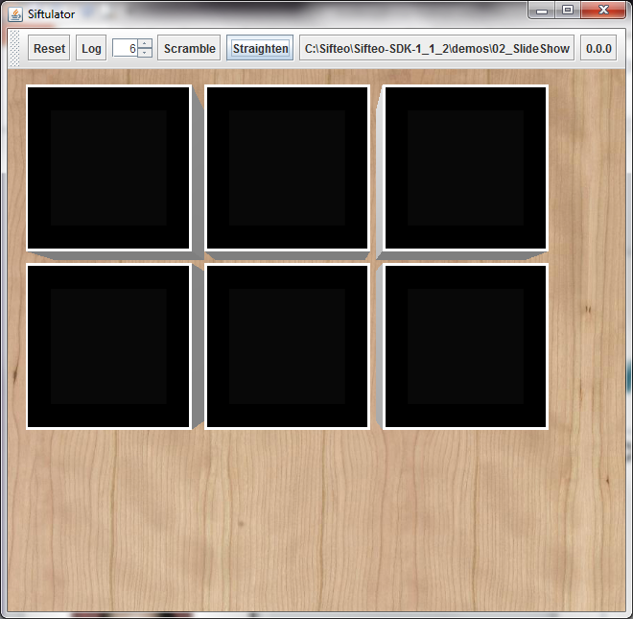
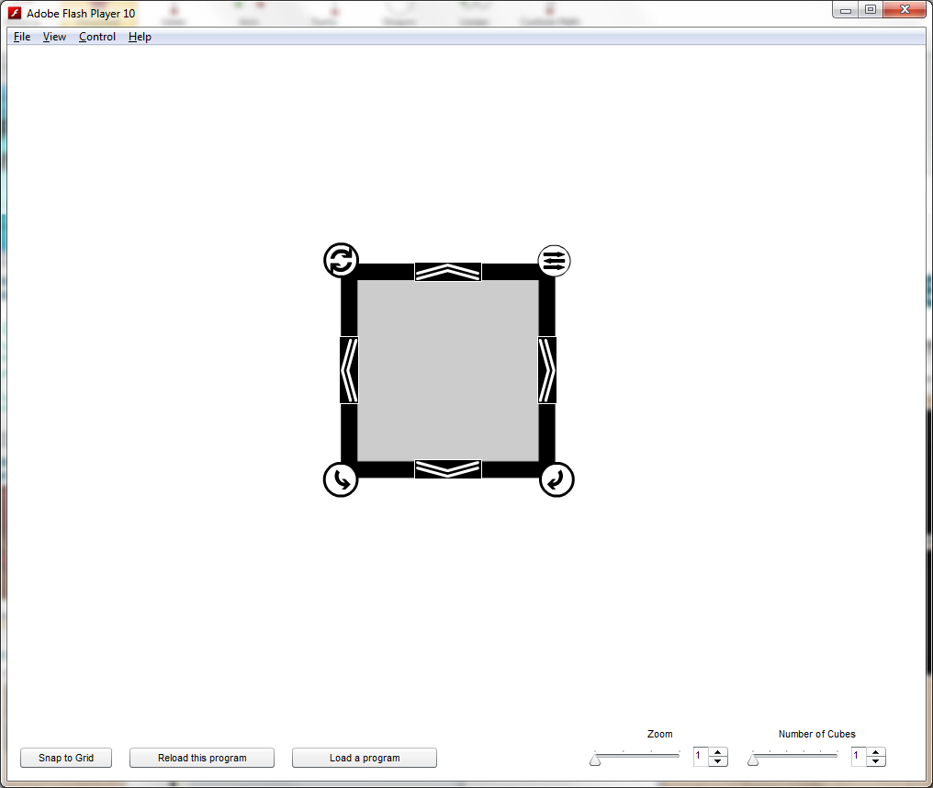
What is the need?

Slide 5
Mention the critical/important features in the system
A workspace where multiple cubes can be emulated
Buttons to control those cubes
The ability to load programs onto those cubes
Example games to load onto the system
An Application Programming Interface (API)

Slide 6
Mention the goals for your usability study
To determine whether our emulator’s interface was more intuitive than the Siftulator

Slide 7
Mention the findings of your usability study
>

Slide 8
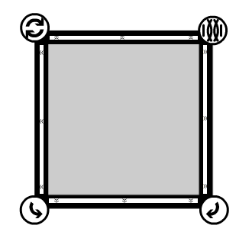
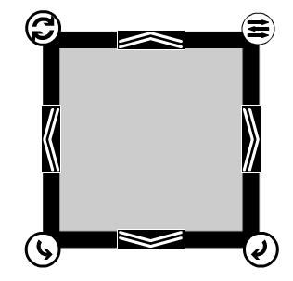
Explain using screenshots changes you made to accommodate the results of the study

Slide 9
Include any other important things you feel the audience must know
…
…
…
…
…
…
Nope. The other things are a lie. As was the cake.

Slide 10

What were the issues you faced this quarter?
The introduction of the Siftulator changed the goals of our project
We’re losing Ruben
We’ll miss you Ruben!!!

Slide 11
What could you have done better as a team/individual?
Take this presentation more seriously
Actually start coding the project

